Slide 1
CV package and deployment

Slide 2

Hello world!
I AM TSHOLOFELO POLE
I am a software engineer at Entelect.
You can find me at:
Tsholofelo.pole@entelect.co.za

Slide 3
Recap of the series
HTML elements and tags
Built our CV
JavaScript and added this to our CV

Slide 4
Recap: Basic HTML page
<!DOCTYPE html>
<html>
<head>
<meta charset=utf-8>
<meta name=viewport content="width=device-width,initial-scale=1">
<title>My title</title>
</head>
<body>
</body>
</html>

Slide 5
Today
JavaScript wrap-up
Learn about electron
Package our CV
As a desktop application
Packaging for Windows and Mac
Publish our CV
Learn about domains

Slide 6
1
Packaging out CV
Let’s set up our environment!

Slide 7
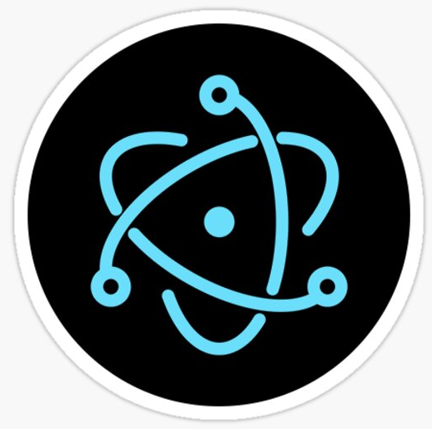
Electron.js
It is a JS library
Library used to package projects
Build a desktop app
Electron is a framework for creating native applications with web technologies like JavaScript, HTML, and CSS
Notes:
Single code base: produce apps for multiple platforms using a single codebase

Slide 8
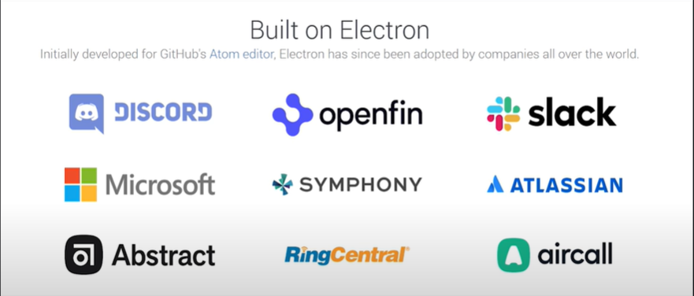
Electron
Notes:
Some applications built using electronjs

Slide 9
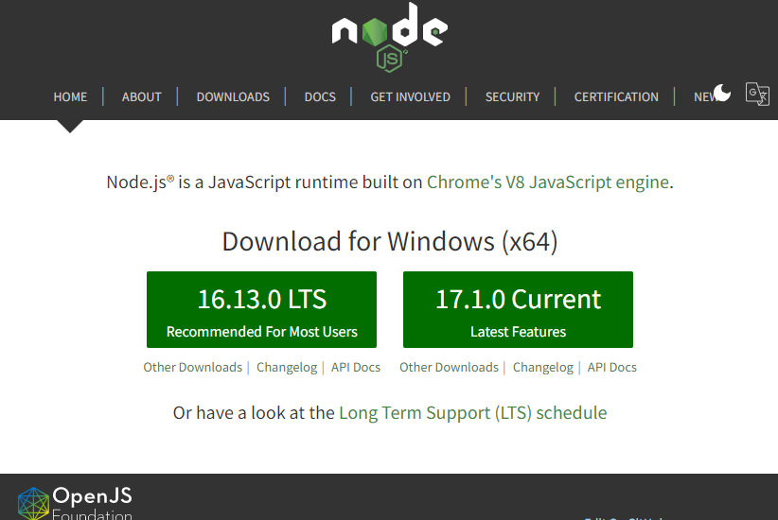
Electron prerequisites
Have node.js installed
Open-source, cross-platform JS runtime environment
Latest node version
Notes:
make sure you have the correct node version
Node.js is an open-source, cross-platform, back-end JavaScript runtime environment that runs on the V8 engine and executes JavaScript code outside a web browser.
Node. js is primarily used for non-blocking, event-driven servers, due to its single-threaded nature. It's used for traditional web sites and back-end API services, but was designed with real-time, push-based architectures in mind.
run the start command to run the app in a webview

Slide 10
A little bit about npm
npm is the package manager for the Node JavaScript platform
Puts modules in a place node would be able to find them
node_modules
Use this in your command line:
npm <command>
Notes:
What is npm and why use it?
npm is the package manager for the Node JavaScript platform. It puts modules in place so that node can find them, and manages dependency conflicts intelligently. It is extremely configurable to support a wide variety of use cases. Most commonly, it is used to publish, discover, install, and develop node programs.

Slide 11
Add files to our project
Add some files to our project directory
Create package.json file
Create a main.js file

Slide 12
Package.json file
Lists packages project uses
Specifies versions of these packages
Makes build reproducible
Run npm init and follow the prompts to complete creating our file
Notes:
Makes it easier to manage to manage and install dependencies
specifies versions of a package that your project can use using semantic versioning rules
makes your build reproducible, and therefore easier to share with other developers
Run a few commands to make sure our environment is ready
Npm --version, node --version

Slide 13
Install electron
Install the library globally
Run: npm install electron --save-dev
Updates our package.json file

Slide 14
Install a few other libraries
Install libraries to package our app
Run: npm install electron-builder --save-dev
Run: npm install electron-packager --save-dev
Updates our package.json file
Notes:
--save-dev installs our package as a dev dependency and will not be packaged with our project

Slide 15
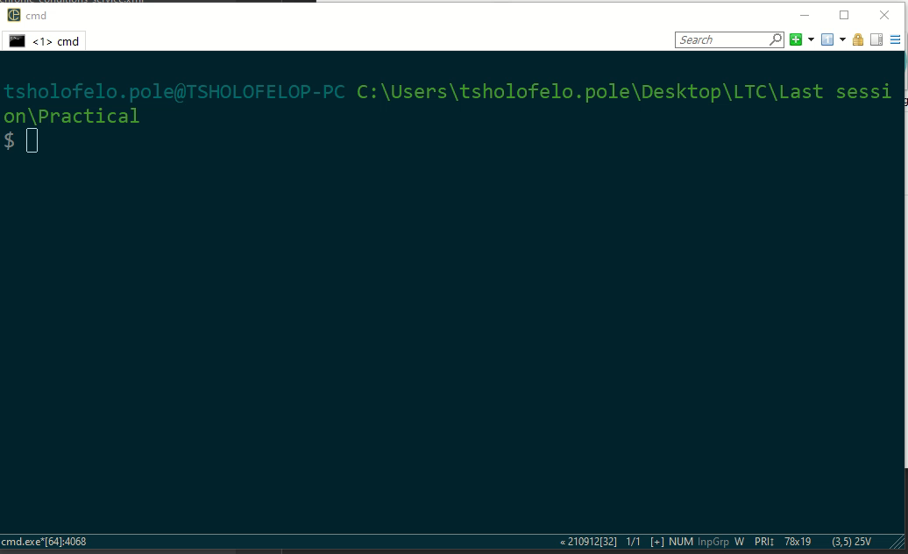

Slide 16
Add scripts to our package.json
List of commands
Commands we will run to build our project
Node lets you create scripts instead of running individual commands
“scripts”: {
….
}

Slide 17
Add scripts to our package.json
Run our project in a chromium browser
"start": "npm install && electron .“
Run this command: npm run start

Slide 18
Main.js update
Tell electron how to package our application
app allows us to listen to the apps lifecycle
const {app, BrowserWindow} = require('electron')
const path = require('path')
const url = require('url')
function createWindow () {
……
}
app.on('ready', createWindow)
Notes:
File that will tell electron how to package our application
an absolute path refers to the same location in a file system relative to the root directory, whereas a
relative path points to a specific location in a file system relative to the current directory you are working on.

Slide 19
Add scripts to our package.json
Package our project for Windows
"package-win": "electron-packager . mycvapp
--icon=icon/cv.png
--overwrite --asar --platform=win32 --prune=true …“
Run this command: npm run package-win

Slide 20
Add scripts to our package.json
Package our project for MAC
"package-mac": "electron-packager . mycvapp
--overwrite --platform=Darwin --arch=x64
--icon=icon/cv.png --prune=true
--out=release-builds …“
Run this command: npm run package-mac
I do not own a Mac, but this command should produce a desktop app for Mac😋

Slide 21
Build using electron-builder
Package our project for different environments
Takes the packages produced by electron-packager and creates automated installers
electron-builder --win
electron-builder --mac
electron-builder --linux

Slide 22
2
Deploy our CV

Slide 23

Deploy on Netlify
Netlify is a service deploying web projects
Deploy static websites easily
Easy setup
Automatically build your site and deploys it
Any branch or PR gets an automatic staging url

Slide 24
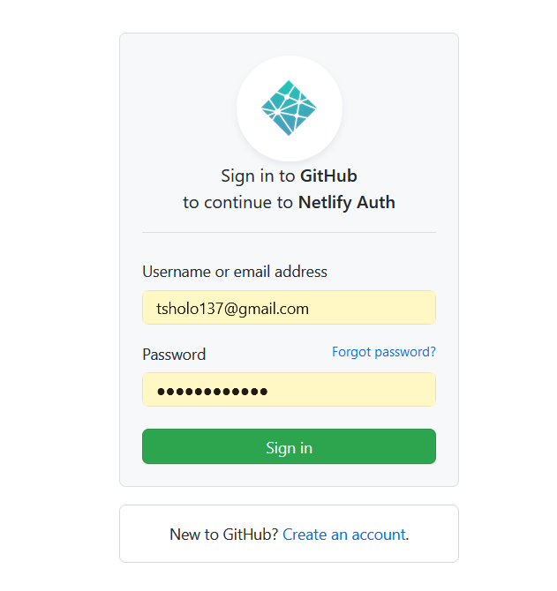
Link github repo to Netlify
Have a file named index.html
Entry point to your site

Slide 25
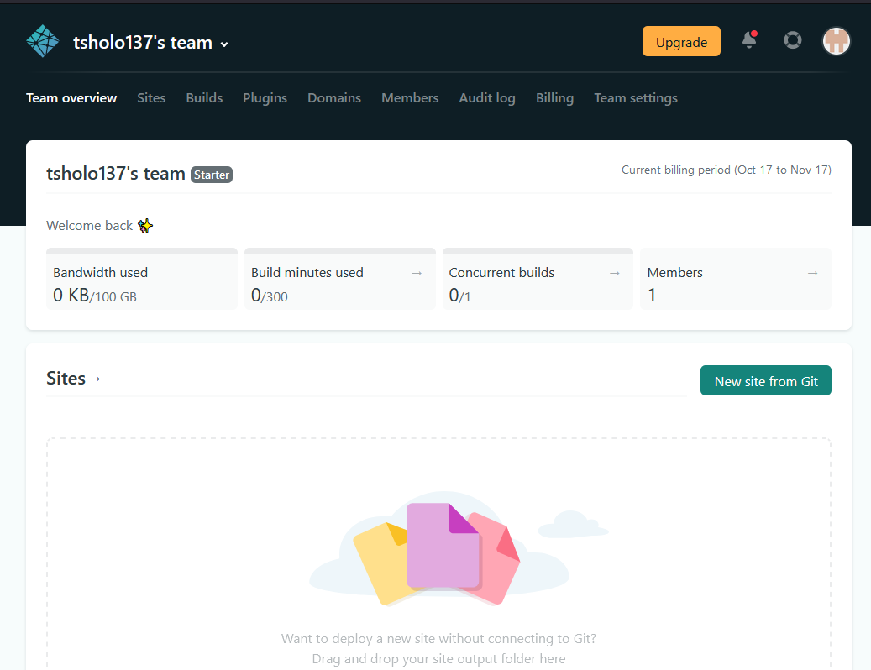

Slide 26
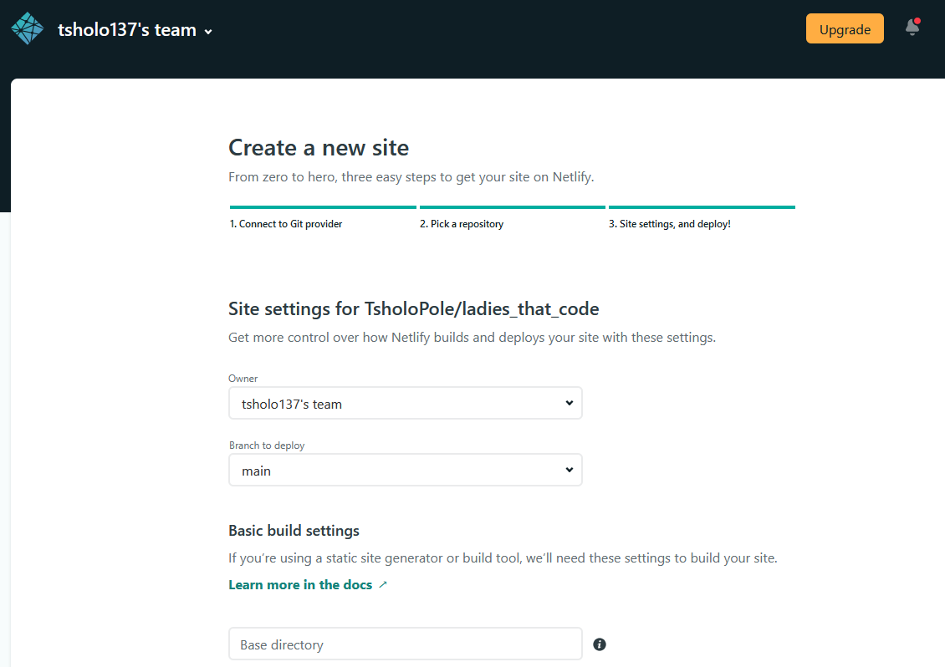

Slide 27
Useful links
https://nodejs.org/en/
https://www.digitalocean.com/community/tutorials/how-to-create-your-first-cross-platform-desktop-application-with-electron-on-macos
https://www.netlify.com/

Slide 28
Thanks!
ANY QUESTIONS?
You can find me at:
tsholofelo.pole@entelect.co.za

Slide 29
Now you can use any emoji as an icon!
And of course it resizes without losing quality and you can change the color.
How? Follow Google instructions https://twitter.com/googledocs/status/730087240156643328
😉
✋👆👉👍👤👦👧👨👩👪💃🏃💑❤😂😉😋😒😭👶😸🐟🍒🍔💣📌📖🔨🎃🎈🎨🏈🏰🌏🔌🔑

